Slide 1
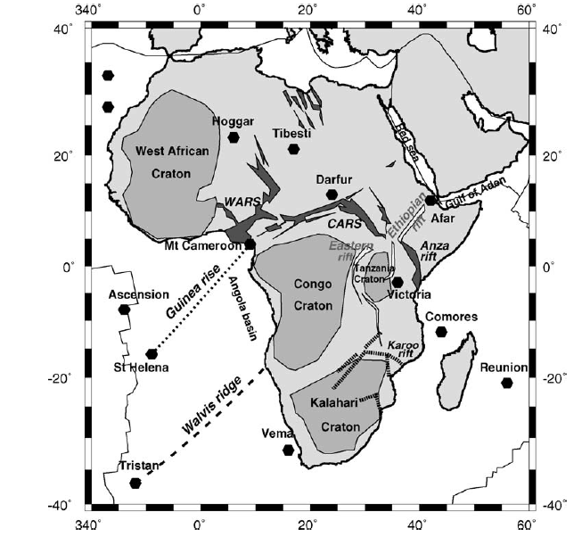
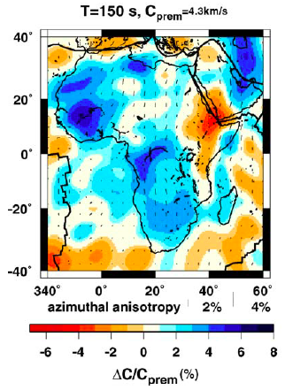
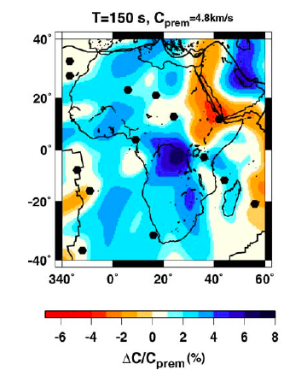
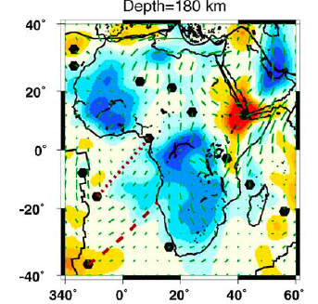
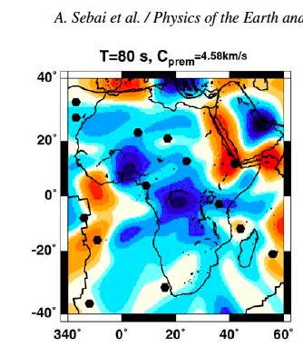
R
L
VSV
L

Slide 2
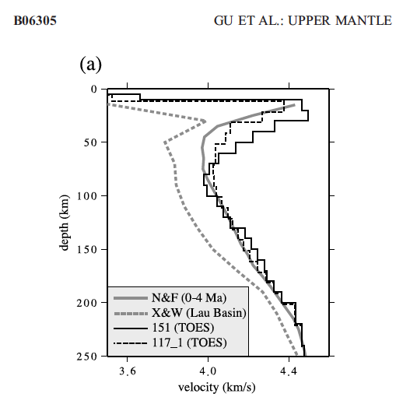
Notes:
The high lid velocity required by event 151 is characteristic of older oceanic lithosphere (>4 Ma) [e.g., Nishimura and Forsyth ,
1989], which appears anomalous based on the path average
age of 1.5 Ma we calculated from a global age model Figure 6. (a) Shear velocity with depth for the northern
EPR. ‘‘N&F (0–4Ma)’’ represents the vertical shear wave
speed of Nishimura and Forsyth [1989], determined for a
0–4 Myr oceanic mantle using surface wave dispersion
measurements. ‘‘X&W’’ represents the Lau Basin shear
velocity model of Xu and Wiens [1997] using a 1-D
waveform inversion approach.

Slide 3
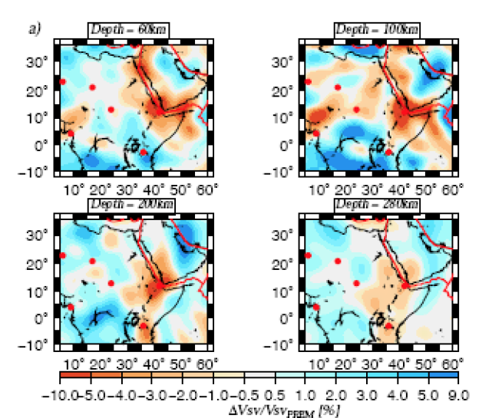
Notes:
Therefore, the African continent shows two families of upwellings. Some upwellings beneath the Afar hotspot
and possibly the Victoria hotspot, have a deep origin at least down to the transition zone. The signature of the
Afar upwelling in the lower mantle is not obvious in the new model PRI-S05 (Montelli et al. [2006]). Following the
classification of Courtillot et al. [2003], and by using global tomography and fluid dynamics constraints, the Afar
upwelling might be a primary plume, whose connection with the lower mantle might have already disappeared
(Davaille et al. [2005]). Others, such as the Central Africa hotspots (Darfur, Tibesti, Hoggar), have a superficial
character, resulting from the interaction between lithosphere and asthenosphere. Their shallow signature and
the distinction between a heterogeneous W-E structure and a relatively homogeneous and slow SW-NE profile
following the East-African Rift (Fig. 8a) could suggest that the presence of the Central Africa hotspots is due to
convective instabilities in the asthenosphere and/or are related to the edge-driven convection process (King and
Ritsema [2000]) in a continental environment between cratons and more recent zones in north-central Africa. The
typical continental breakup (see for example Courtillot et al. [1999]) has been associated with the onset of hotspot
and flood basalts. In that respect, the Afar upwelling was not completely successful for breaking up Africa along
the East African rifts, but succeeded in the opening of the Red Sea and Gulf of Aden rifts. CASZ (Central Africa
Shear Zone) might be an example of an aborted ridge, which presents lines of weaknesses and where the volcanic
activity have been reactivated by the birth of the Afar hotspot through convective instabilities at the base of the
lithosphere. The complex interaction between the Afar upwelling, the African lithosphere and asthenosphere has
been revealed through the geographical distribution of seismic azimuthal and radial anisotropies.

Slide 4
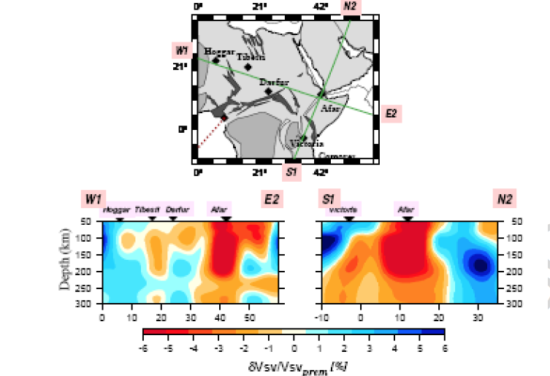
Notes:
(a) Perturbations of the SV -wave velocities
expressed relative to the PREM values at 60km (top
left), 100km (top right), 200km (bottom left) and 280km
(bottom right) depth. (b) The azimuthal anisotropy
(G parameters) with the fast directions of horizontally
propagating SV -waves.The red circles correspond to the
African hotspots in the list of Courtillot et al. (2003).

Slide 5
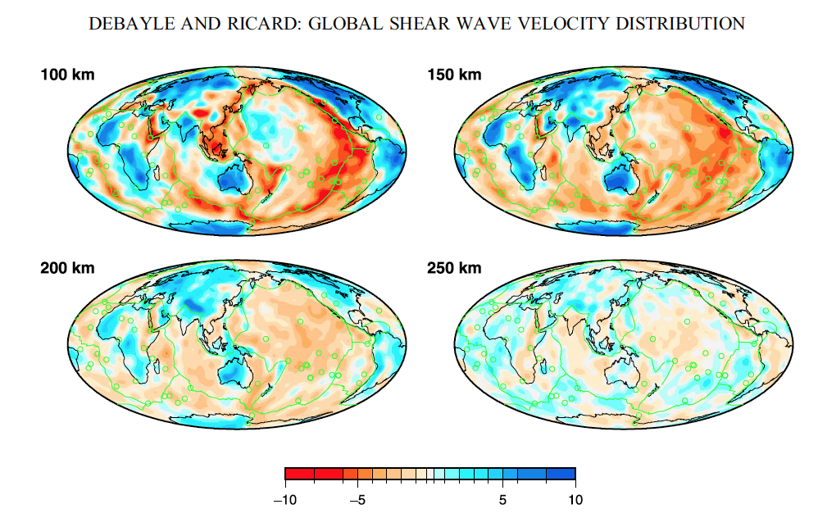
Notes:
----- Meeting Notes (8/13/13 08:04) -----
By 250 km depth the ridge system has essentially disppeared from tomographic maps except for isolated patches and ridge parallel structures well offset from the surface expression of ridges.

Slide 6
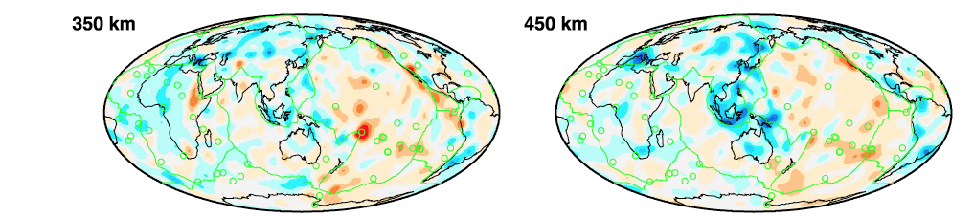
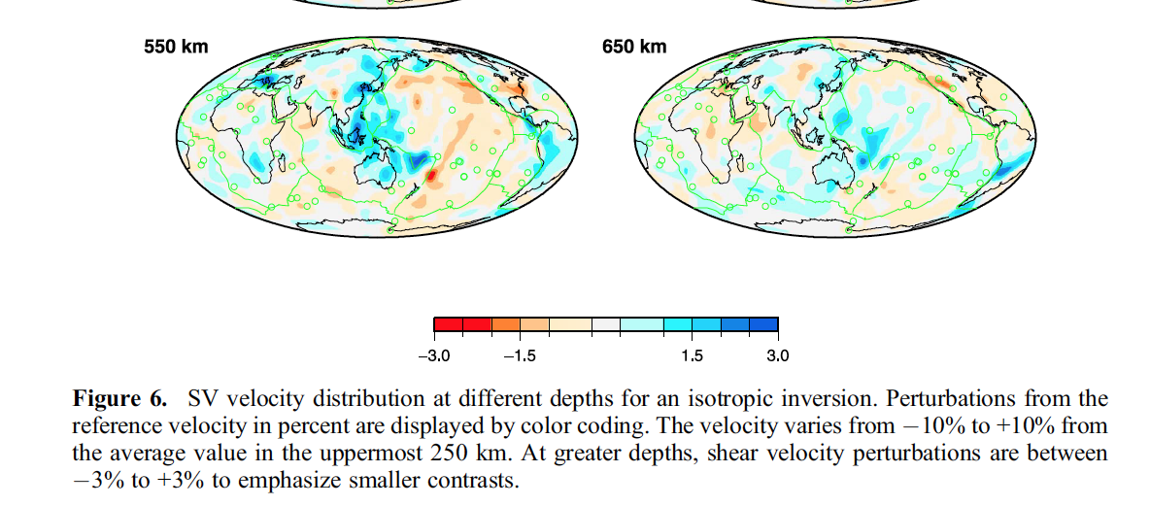

Slide 7
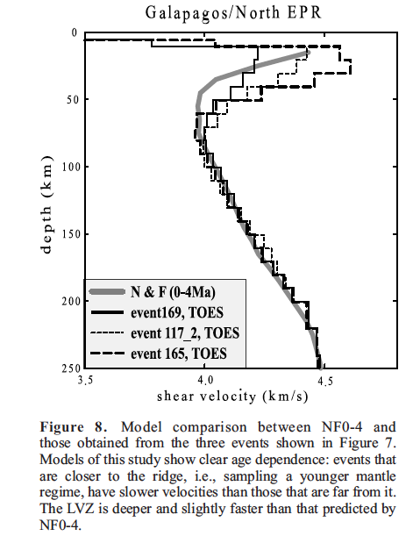
Notes:
The LVZ velocity of paths sampling the northern EPR and Galapagos ridge shows a mean value of 4.0–4.1 km s1 , with no dependence on the path age (see Figure 15c). These velocities are consistent with an
asthenosphere containing a small amount of partial melt [Forsyth , 1992],… The data from the southern EPR shows 3.8–4.0 km s1 LVZ shear velocities, consistent with the presence of partial melt at these depths throughout the region. The LVZ velocities also exhibit a strong dependence on path age (see Figure 15c). This age dependence is probably not a reflection of plate cooling or the lack ofvertical resolution in our models, as it is observed only for the southern EPR paths. Rather, it suggests that themelt distribution at 50–100 km depth beneath the southernEPR is concentrated near the ridgeaxis,andtheconcentration progressively weakens further away fromthe axis.Our uppermantle models display strong variability in seismic velocitiesthat appear to be a function of age, as well as oflocation along the ridge axis.

Slide 8
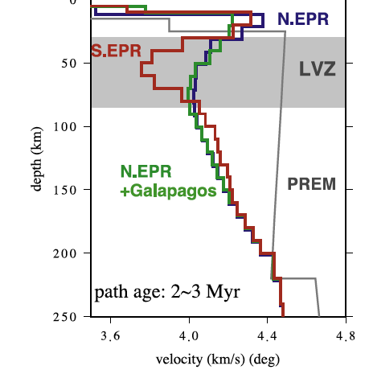
isotropic
Notes:
A comparison for three typical events, all with average path ages of 2–3 Myr. The two events that sample the northern EPR and Galapagos ridge both contain a relatively mild
LVZ, consistent with NF0-4. The southern EPR, however,shows a pronounced LVZ approximately 0.3 km/s slowerthan the others. The regional models of oceanic mantle are
substantially slower than Voigt-averaged, isotropic PREMvelocities in the top 250 km. One well-known issue is that wave speedsin mantle rocks are anisotropic, that is, shear wave velocities
have strong dependencies on the direction of propagationand polarization. Although the majority of the data inthis study can be modeled well using a simple isotropicwaveform approach,

Slide 9
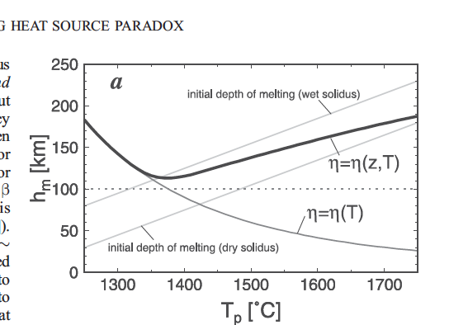
Notes:
Korenaga. Based on a scaling law derived for the onset of convection with temperature-dependent viscosity [Korenaga and Jordan ,2002], we calculate the variation of plate thickness as a function of mantle temperature (Figure 1a). Figure 1. (a) Plate thickness variation as a function of mantle potential temperature (which is the hypothetical
temperature of mantle adiabatically brought to the surface without melting). The critical Rayleigh number is set as 2000. Cases of temperature-dependent viscosity (thick gray
curve) and temperature- and depth-dependent viscosity
(thick solid curve) are shown.

Slide 10
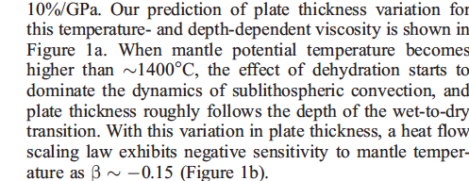
Notes:
Korenaga
Based on a recently
developed scaling law derived for the onset of convection
with temperature-dependent viscosity [Korenaga and Jordan ,
2002], we calculate the variation of plate thickness as a
function of mantle temperature (Figure 1a).

Slide 11
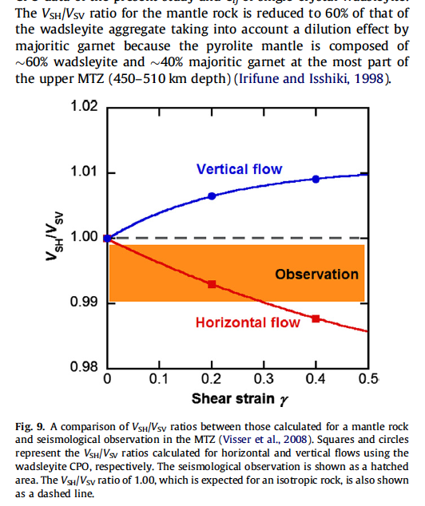
Notes:
polarization seismic anisotropy in the MTZ is between those developed by the horizontal and vertical flows in the MTZ based on the wadsleyite CPO. Under the assumption that the wadsleyite CPO observed
in the present study dominates in the MTZ, the polarizationanisotropy (VSH/VSV: 0.992–0.996 ± 0.002) reported by Visser et al. (2008) can be attributed to predominance of the horizontalflow in the MTZ with small contribution of the vertical flow. In contrast, the polarization anisotropy, VSH/VSV, of 1.002–1.005, whichwas reported by the previous seismological observation (Montagnerand Kennett, 1996), is explained by predominance of the verticalflow in the MTZ with small contribution of the horizontal flow.

Slide 12
ridge
LID
LVZ
LLAMA
200
400
km
Mesosphere (TZ)
Ridges fed by broad upwellings plus flow along, and lateral flow toward, ridges

Slide 13
Map view
depths
400 km
deep
Broad upwellings from MORB source
Background
200 km depth
400 km
deep
200
km
ridge
Notes:
Map view of subplate mantle showing (in pink) along ridge flow and lateral flow from TZ upwellings

Slide 14
Along-ridge profile
R I d g e
ridge
Ridge-normal profile

Slide 15
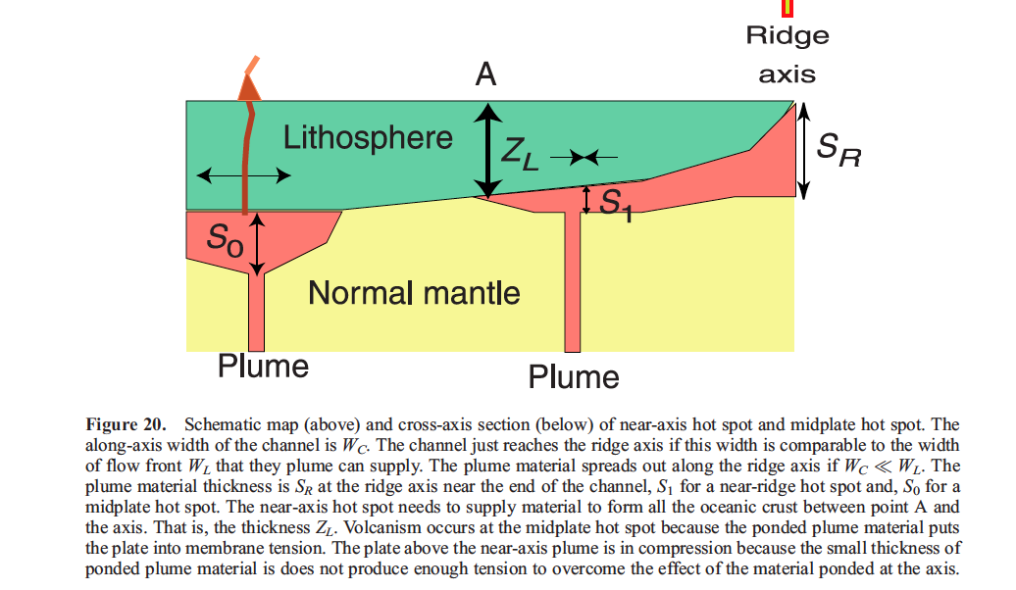

Slide 16
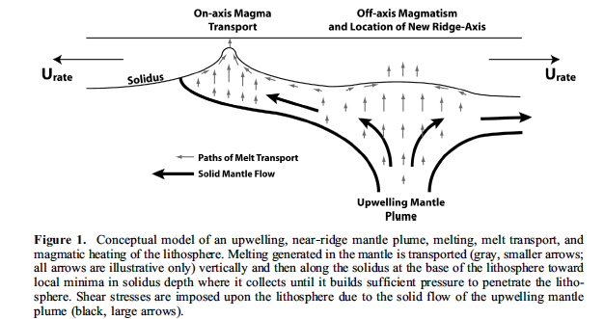

Slide 17
Surface of mantle
LID
1600 C
Tp=1300 C
1300 C
Notes:
Perturbation by cold passive upwelling.

Slide 18
olivine
eclogite
Initial condition
Steady-state conduction
boundary layer
220 km
650 km
1600 C
1400 C
Internal heating
Secular cooling
Subadiabatic thermal gradient
Notes:
The initial condition is a half-space that has already been cooling for >1Gyr and has established a thick conduction surface boundary laye (BL) r. The secular cooling combined with the decaying internal heat sources
has established a subadiabatic gradient below the BL.
In the usual half-space and plate models the initial condiction is an isothermal halfspace with horizontal isotherms spaced according to an adiabatic gradient.

Slide 19

Tatsumoto Model (1978)
LLAMA Model
ridge
OIB source
FERTILE DEPLETED MORB SOURCE
BARREN LOWER MANTLE
Notes:
Upwellings at ridges are 3D and apparently extend into the TZ…

Slide 20
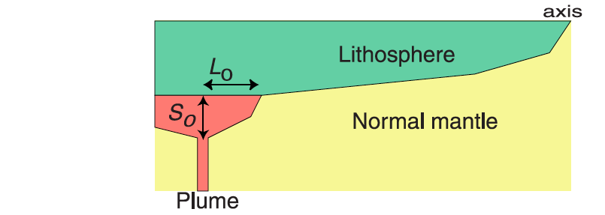
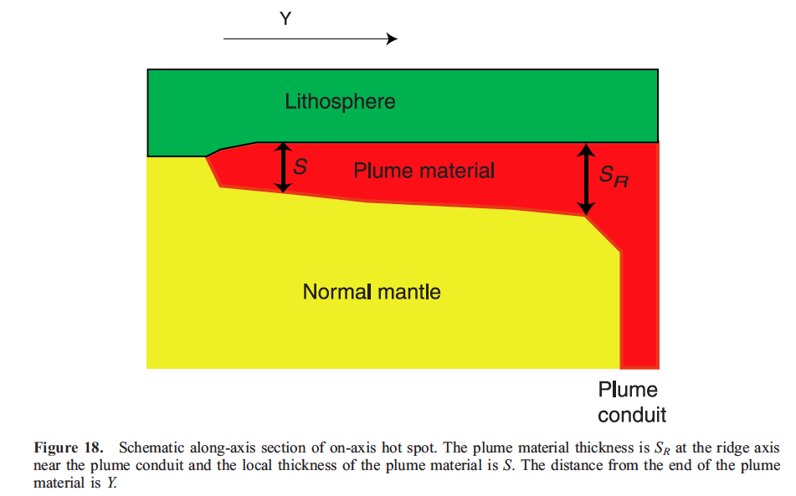

Slide 21
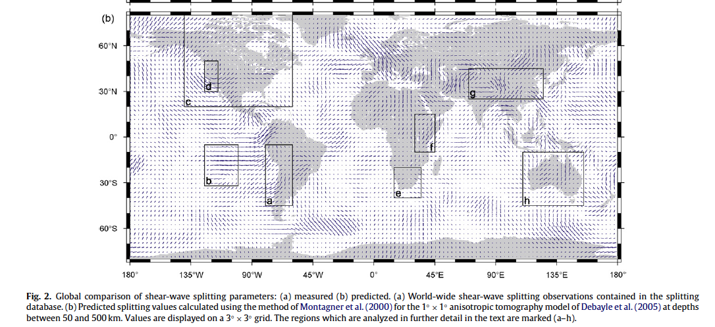

Slide 22
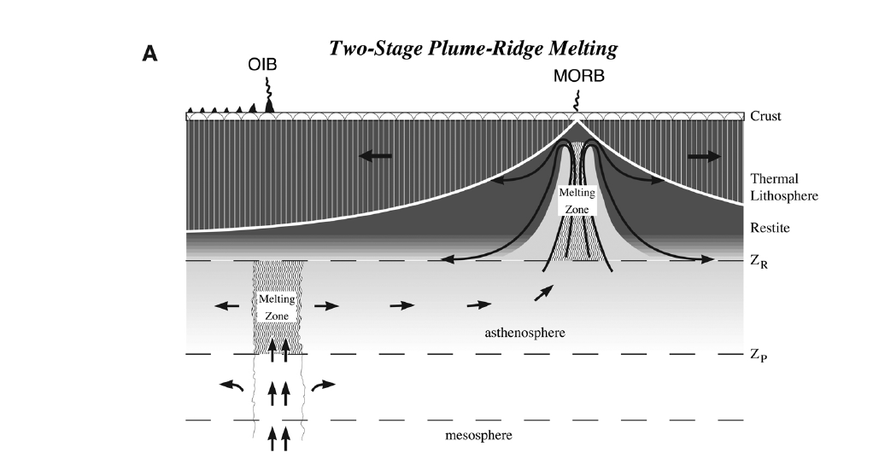

Slide 23
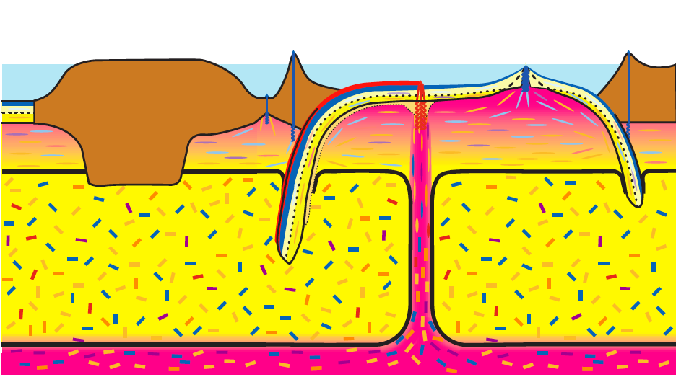


Slide 24
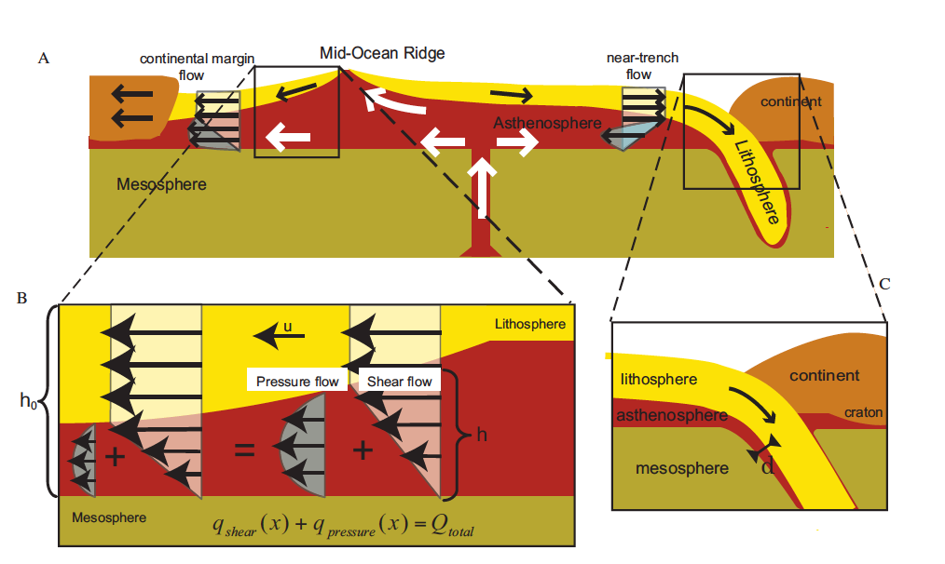

Slide 25
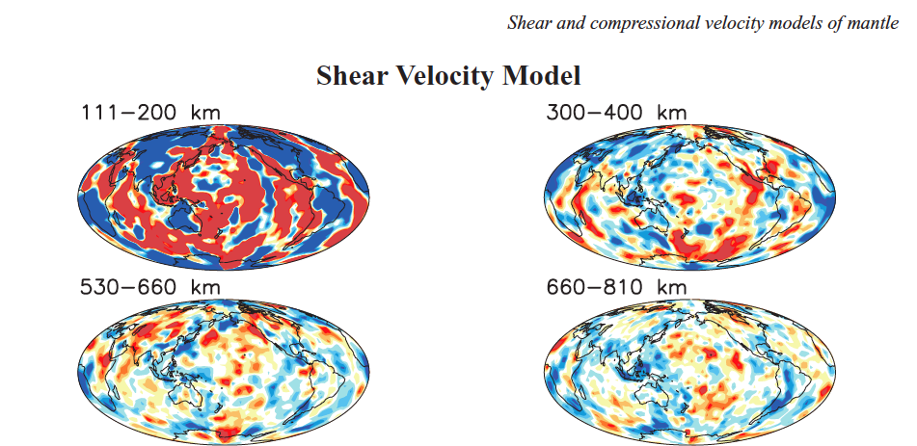
Notes:
Masters, Houser
Figure 8. Depth slices of cluster analysis shear velocity model, HMSL-S06, where the mean from each layer has been removed. Dark red and blue areas represent anomalies that are 2 per cent slow and fast, respectively. The largest anomalies occur in the upper and lower BLs, within a few hundred kilometres of the surface and the core–mantle boundary (CMB).

Slide 26
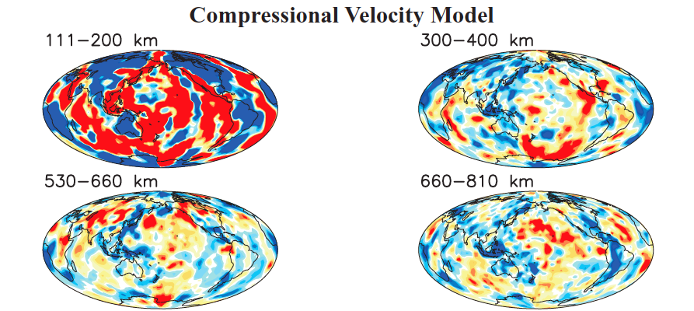
Notes:
The Red Sea-Afar, Iceland, the SW Pacific-Antarctic ridge, the central Indian ocean and Galapagos spreading centers are the most prominent examples of ridges that can be traced down to TZ depths

Slide 27

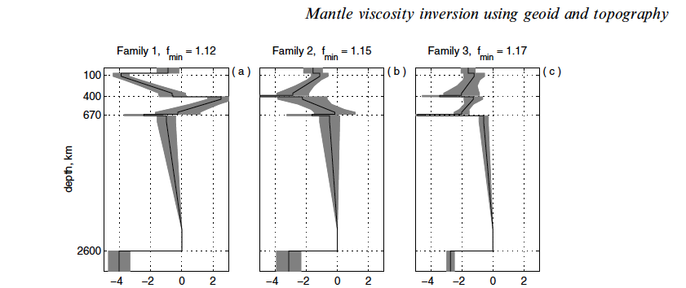
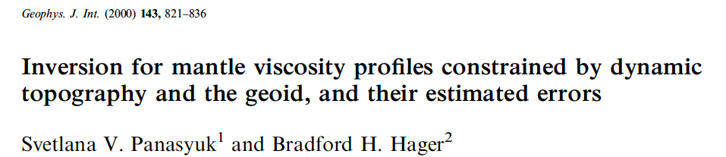
Notes:
The TZ is not particularly low viscosity

Slide 28
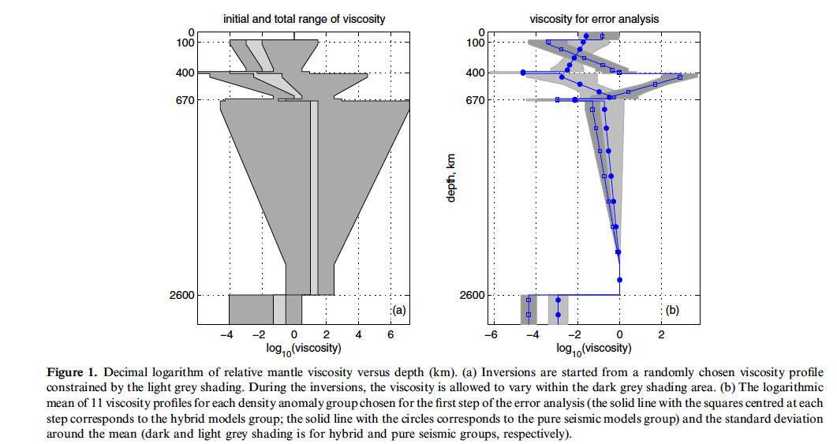

Slide 29
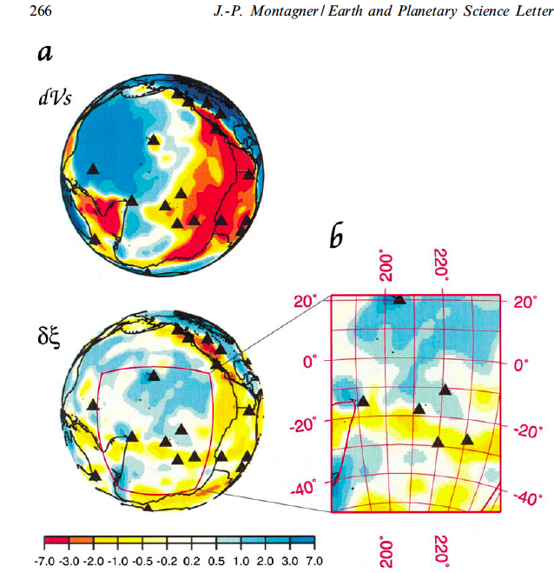
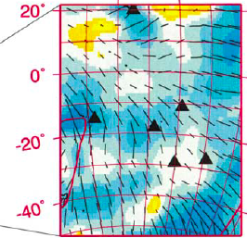
Notes:
Channels of low anisotropy to a depth of 200 km ( LAC) are observed and are the best resolved anomalies: one EW channel between Easter Island and the Tonga-Kermadec
(observed with radial and azimuthal anisotropies) and one (only observed on azimuthal anisotropy) extending from the SW Pacific up to SE Hawaii, and passing through the Polynesia hotspot group for
plate older than about 40 Ma. These features provide strong constraints on decoupling between the plate and asthenosphere.

Slide 30
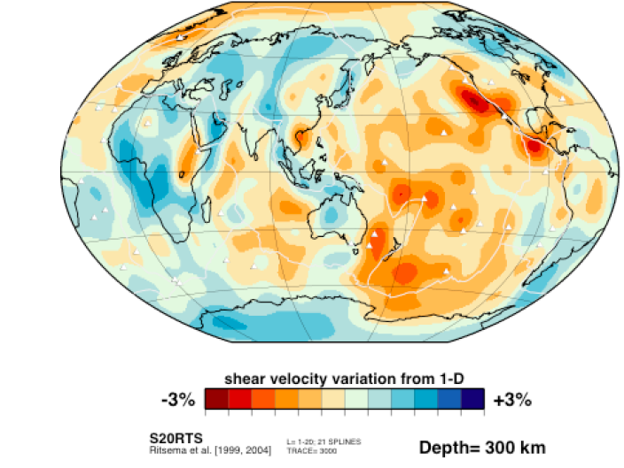

Slide 31
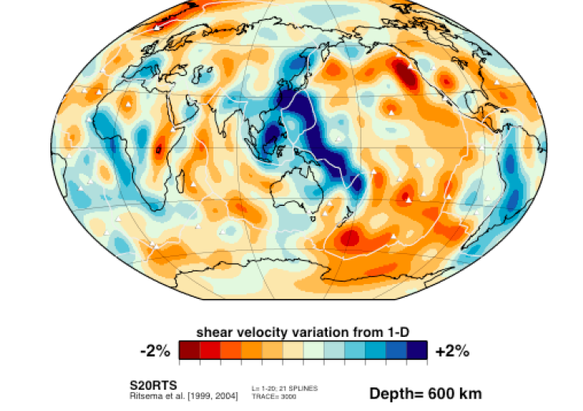

Slide 32
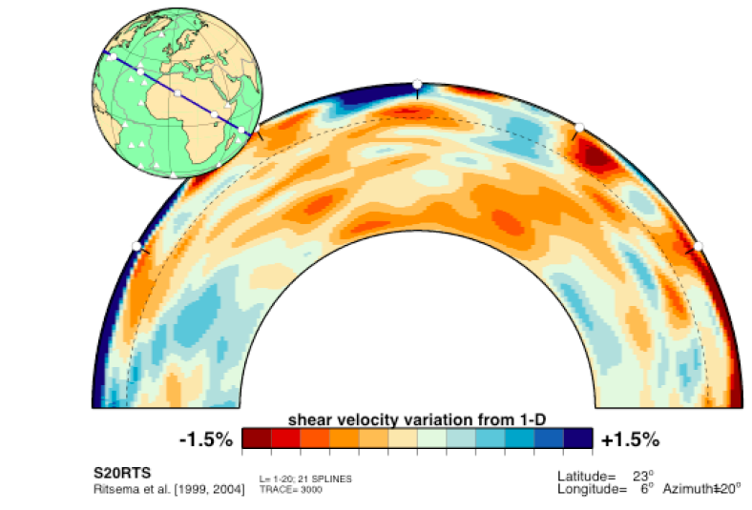

Slide 33
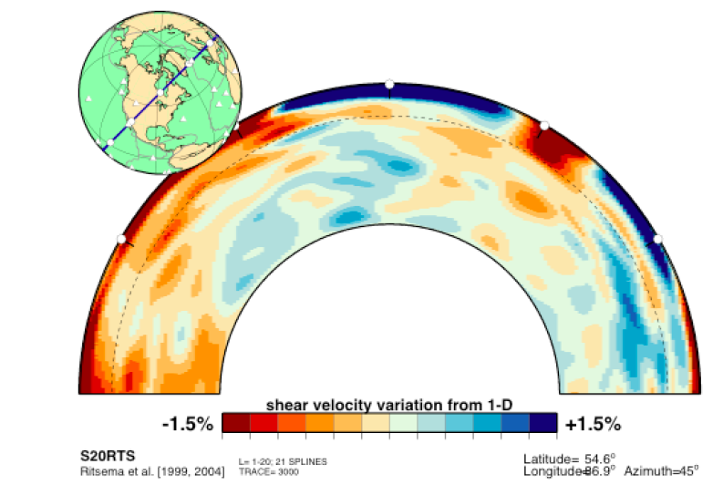

Slide 34
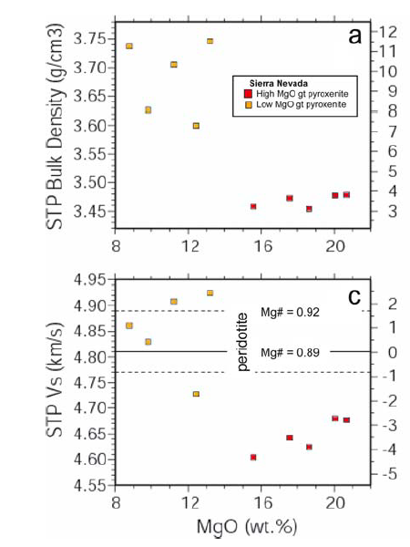
Notes:
3.25 forsterite, 3.33 lid; harzburgites 3.22 g/cc

Slide 35
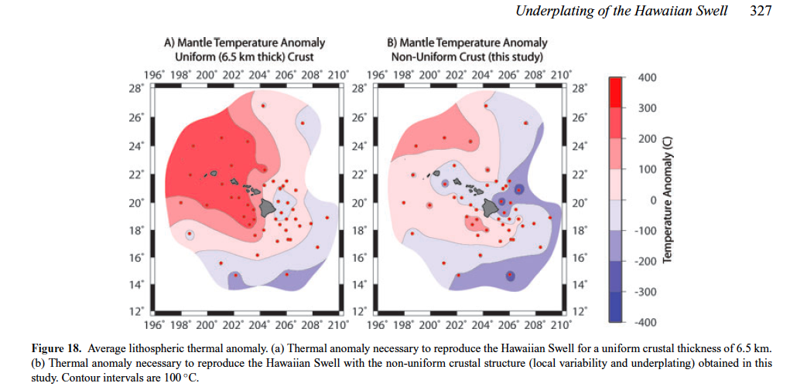
Notes:
-300 C relative to previous estimates to the N and NW, 100-200 C relative to previous estimates to the SE. Half the total variation with constant crust.

Slide 36
For Dean
11/12/12
The evidence for relatively cold mantle under and near ridges is 1. the depressed residual bathymetry & low subsidence rates, 2. the higher than predicted seismic wavespeeds and the lateral decrease of wavespeed away from ridges below 170 km depth.
The evidence for deep adiabatic passive upwelling is the VSV>VSH anisotropy. The combination of high wavespeed, and possibly dense mantle below 170 km and ridge suction suggests that upwelling under ridges is passive and adiabatic. The ridge geotherm approximates a ~1300 C adiabat.

Slide 37
Anderson, Don L., Tanimoto, T., and Zhang,Y.-S., 1992,
Plate tectonics and hotspots: The third dimension, Science, v. 256,
p. 1645-1650.
410-km
McKenzie & Bickle (1988) argue that the mantle below 100-km depth is homogeneous, isothermal & adiabatic; this implies a cold subsolidus boundary layer & hot “jets”
Notes:
----- Meeting Notes (8/13/13 08:04) -----
The alternative is that ambient mantle is ~200 C hotter than the adiabatic upwelling under ridges...

Slide 38
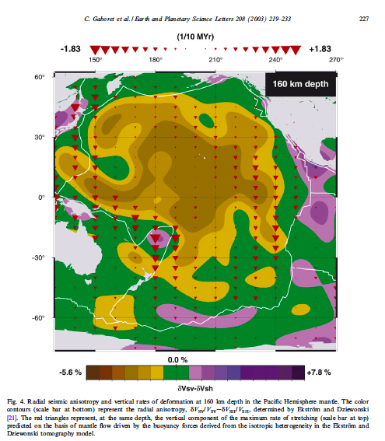
Notes:
Fig. 4. Radial seismic anisotropy and vertical rates of deformation at 160 km depth in the PaciÅëc Hemisphere mantle. The color
contours (scale bar at bottom) represent the radial anisotropy, NVSV/VSV3NVSH/VSH, determined by Ekstro.m and Dziewonski
[21]. The red triangles represent, at the same depth, the vertical component of the maximum rate of stretching (scale bar at top)
predicted on the basis of mantle Åíow driven by the buoyancy forces derived from the isotropic heterogeneity in the Ekstro.m and
Dziewonski tomography model.

Slide 39
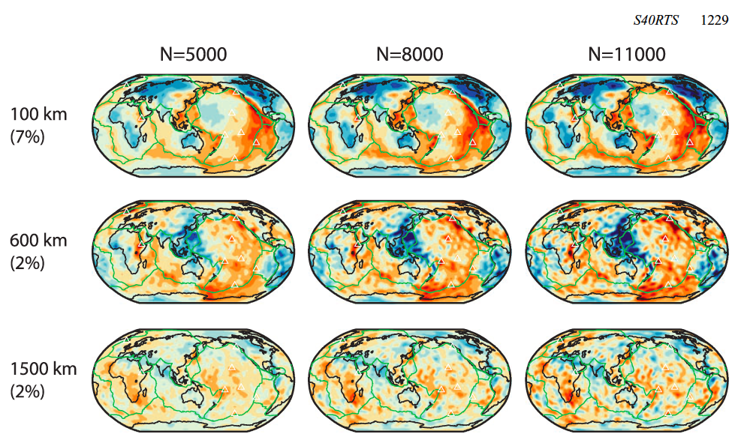
Notes:
The change in the pattern of shear-velocity variation across the 650-km discontinuity is much stronger in S40RTS than in older studies that argued for slab penetration and whole mantle convection. This change is obvious in the spectra and maps and illustrate that this is not confined to the subduction zone regions. The profound
change of shear-velocity heterogeneity across the 660 km depth was previously reported by Gu et al. (2001) and Ritsema et al. (2004).
It indicates that the 660-km boundary marks a change in seismic
velocity heterogeneity between the upper and lower mantle.
----- Meeting Notes (8/13/13 08:04) -----
At 600 km depth the ridge system appears again, faintly...

Slide 40
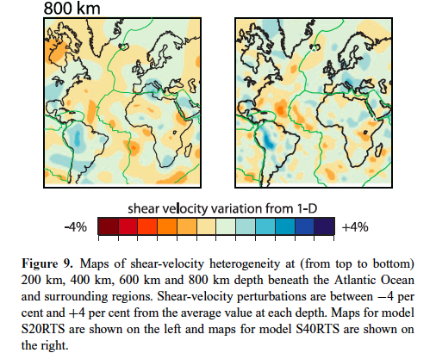
Notes:
Note that apparent continuities and ridge and slab correlations below 600 km are lost in the newer models…

Slide 41
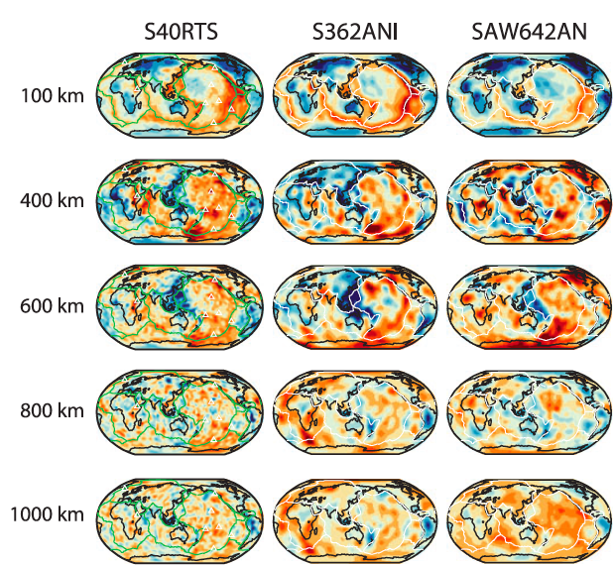
Notes:
Model S362ANI is a whole-mantle shear-velocity model derived from surface-wave dispersion, surface- and body-wave waveforms and body-wave travel-times.
The data are inverted for isotropic Voigt average shear velocity and variations in shear-velocity anisotropy in the upper mantle…Model SAW642AN is a whole-mantle anisotropic model of
the mantle derived from three-component surface-wave and bodywave waveforms…shear velocity and the parameter η that represents the ratio of horizontally and vertically polarized shear wave speed.

Slide 42
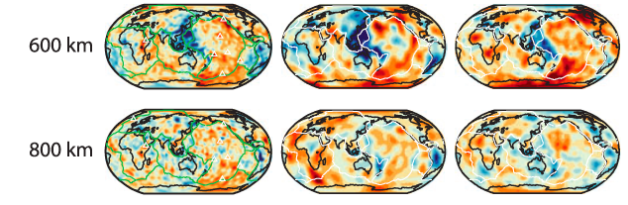
Isotropic anisotropic
Notes:
Below 200 km the ridge related signals become fragmented and offset from the ridges. However, they seem to connect to ridges at shallow depths.

Slide 43
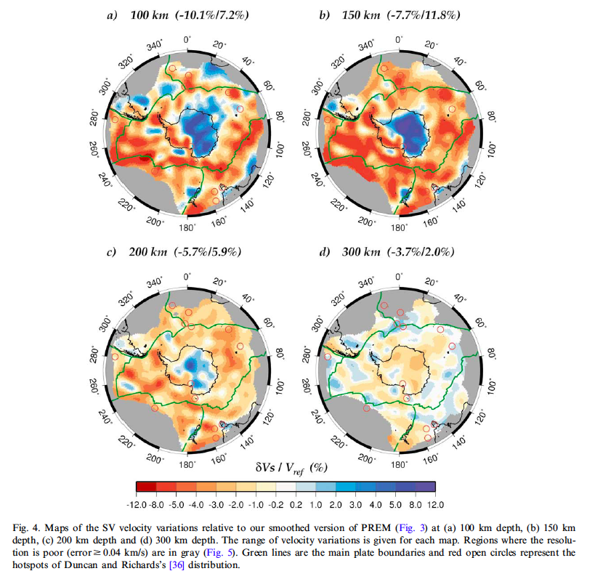
Notes:
----- Meeting Notes (8/13/13 08:04) -----
At depths below 200 km the spreading ridge surrounding Antarctica is characterized by a shear velocity gradient from fast under the ridge to slower into plate interiors.

Slide 44
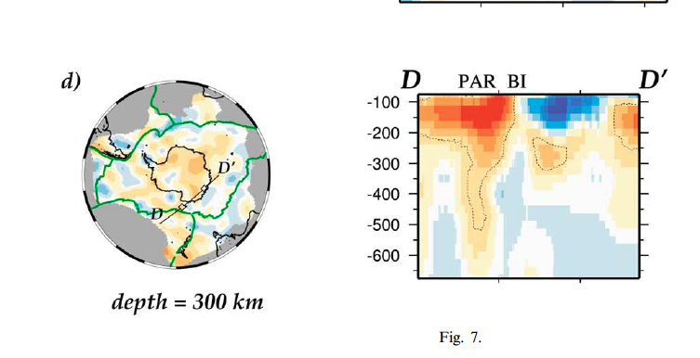
Notes:
Ridges are most pronounced above 200 km depth, but some ridge segments can be traced down to 600 km and some non ridge regions have similar deep structures that merge with ridges below 200 km… In oceanic areas, the low-velocity signature ofthe mid-oceanic ridges surrounding Antarctica is rather shallow and vanishes at 150 km depth. The amplitude of the seismic anomaly is correlated with spreading rates, the strongest low-velocity anomalies being associated with the fastest ridges (the East PaciÅëc Rise, the South East Indian Ridge, see Fig. 4a ). An exception is the Australian^ Antarctic Discordance (AAD), a peculiar region of the South East Indian Ridge lying between 120‡E and 127‡E. In our model, this area is associated with a structure relatively fast compared to the neighboring portions of the ridge…

Slide 45
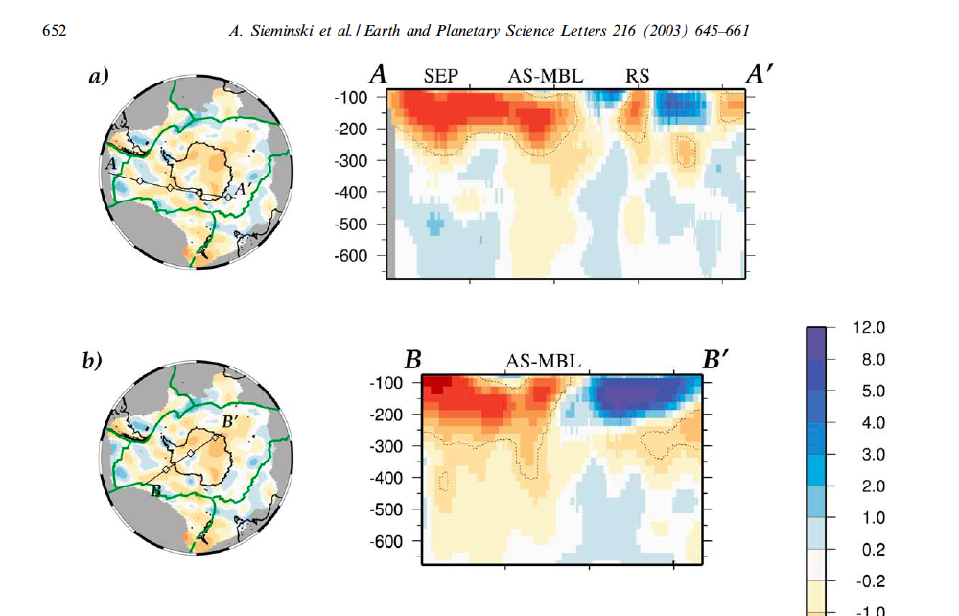
Notes:
Ridge anomalies surrounding Antarctica can be traced down to 600 km but similar anomalies occur off-ridge that merge with the ridge anmaly at shallow depths. On cross-sections CCP
and DDP , another continuous low-velocity vertical structure with an amplitude greater than 1% is found down to 600 km depth beneath a portion of the PaciÅëc^Antarctic Ridge (PAR) close to the
Balleny Islands (BI). The AS-MBL, PAR and RS …Some anomalies are remarkable because they are continuous from the asthenosphere down to transition zone depths, and they are not likely to be
artefacts of the method, as shown by synthetic experiments

Slide 46
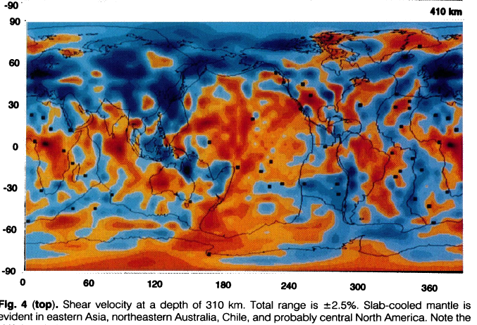
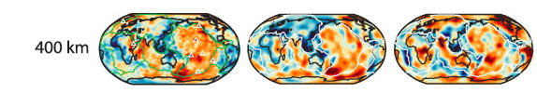
Notes:
Anderson et al. [38] suggested that some of the low velocities observed in the asthenosphere could reÅíect previous positions of migrating ridges… anomalies in the SE Pacific Ocean and the South Indian Ocean also persist at relatively large depths in the mantle.
----- Meeting Notes (8/13/13 08:04) -----
At 410 km depth the average ridge is distinctly faster than the average ocean at these depths…this may be related to the observation that the average ridge residual tompograhy is also depressed relative to average ocean...

Slide 47
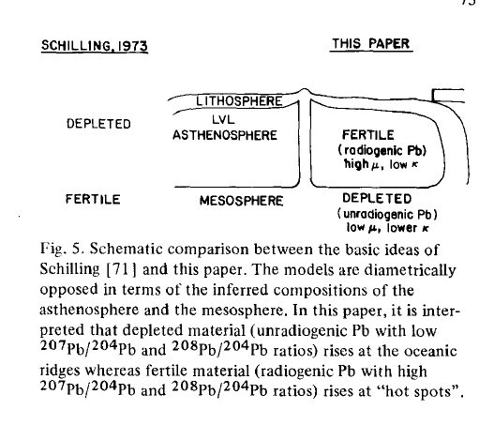
Notes:
It is important to note at this stage that Tatsumoto’s geochemical evolution model is completely opposite to Schilling's ([71 ] ;Brooks et al. [79]) as schematically illustrated in Fig. 5. Tatsumoto and Boirch envision that LIL elements were concentrated upward during the primary differentiation of the Earth and that the Hawaiian plume or blob is generated in this fertile asthenosphere (inner part of the convection cell, see Fig. 10).

Slide 48
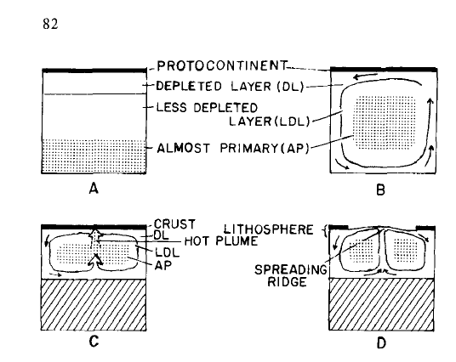
Notes:
Tatsumoto

Slide 49
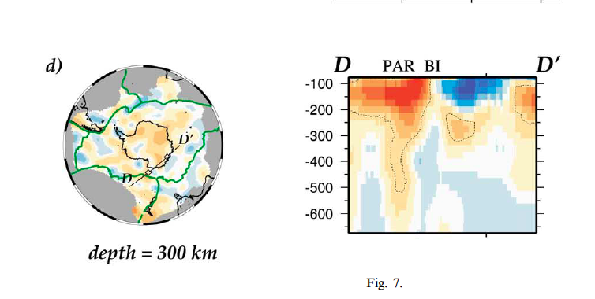


Slide 50
ridge
Introduce plums
Remove plums
LOWER MANTLE
CMB
PLUME-FED ASTHENOSPHERE

Slide 51

Notes:
Not only do HVA and LVA (slabs and plumes) end at 650 km from but deep features are terminated by 650 .

Slide 52


Notes:
Not only do HVA and LVA (slabs and plumes) end at 650 km from but deep features are terminated by 650 .

Slide 53


Slide 55

Theory- Hawaii (Ballmer et al.)

Slide 56



Slide 58
Notes:
Some ridges extend to great depth.

Slide 59

Notes:
Most surface features (except for some ridge segments) terminate at ~220 km depth but deep features with VSH>VSV appear to be
upwellings, also terminate at the 220 boundary

Slide 60

Notes:
Although the tomographic signatures of most ridges terminate above 200 km depth, some features that may be ridge-related, but often offset, extend much deeper.

Slide 61

Notes:
Fig. 7 (a), (b), (c) and (d) Vertical cross-sections from 75 to 675 km depth along the profiles plotted on the maps. The velocity variations are calculated relatively to a smoothed version of PREM (Fig. 3). The contour line displays the 31.6% velocity perturbation which roughly corresponds to twice the a posteriori error (95% conÅëdence level in the results) for depths below 300 km. Empty diamonds are plotted at 20‡ intervals on the paths and correspond to the tickmarks on the cross-sections. Labels above the cross-sections refer to anomalies(SEP, Southeast PaciÅëc; AS^MBL,
Amundsen Sea^Marie Byrd Land; RS, Ross Sea; PAR, PaciÅë c^Antarctic Ridge; and BI, Balleny Islands). (e), (f), (g) and (h) A posteriori error cross-sections corresponding to the cross-sections of (a), (b), (c) and (d). Note that the a posteriori error in all four cross-sections is smaller than 0.04 km/s
down to 675 km depth (except on the left edge of cross-section AAP).

Slide 62


Slide 63


Notes:
Fig. 3. S-wave velocity lateral variations with respect to the
average value written at the bottom on each plot for depths:
(a) 110 km; and (b) 210 km depth; (c) plate boundaries, hot
spot locations and some geological features-after Crough (1983).

Slide 64

Notes:
Xu, Wenbo. Figure 3.10 Kinematic model (Lithgow-Bertelloni and Richards, 1998) of where slabs may be in the transition zone based on 120 Myr of subduction and slabs are slowed down
at 660 km depth due to an expected viscosity contrast between upper mantle and lower mantle. a) slab mass distribution in the depth of 435-570 km; b) slab mass distribution in
the depth of 570-715 km. Some hotspots are on the edges of these projected slab positions (Samoa, Tasmania, Galapagos, Juan Fernandez, San Felix, Afar…
Lithgow-Bertelloni, C. and Richards, M.A. 1998. The Dynamics of Cenozoic and
Mesozoic plate motions.

Slide 65
Notes:
Xu, Wenbo. Figure 3.10 Kinematic model (Lithgow-Bertelloni and Richards, 1998) of where slabs may be in the transition zone based on 120 Myr of subduction and slabs are slowed down
at 660 km depth due to an expected viscosity contrast between upper mantle and lower mantle. a) slab mass distribution in the depth of 435-570 km; b) slab mass distribution in
the depth of 570-715 km. Some hotspots are on the edges of these projected slab positions (Samoa, Tasmania, Galapagos, Juan Fernandez, San Felix, Afar…
Lithgow-Bertelloni, C. and Richards, M.A. 1998. The Dynamics of Cenozoic and
Mesozoic plate motions.

Slide 66

Slabs in TZ
11 hotspots on edges
Ridge-related LVAs
18 hotspots
Notes:
Xu, Wenbo. Figure 3.10 Kinematic model (Lithgow-Bertelloni and Richards, 1998) of where slabs may be in the transition zone based on 120 Myr of subduction and slabs are slowed down
at 660 km depth due to an expected viscosity contrast between upper mantle and lower mantle. a) slab mass distribution in the depth of 435-570 km; b) slab mass distribution in
the depth of 570-715 km. Some hotspots are on the edges of these projected slab positions (Samoa, Tasmania, Galapagos, Juan Fernandez, San Felix, Afar…
Lithgow-Bertelloni, C. and Richards, M.A. 1998. The Dynamics of Cenozoic and
Mesozoic plate motions.

Slide 67
All active hotspots & all reconstructed positions of LIPs lie above regions that did not experience Jurassic to Eocene subduction & above edges of slabs in the TZ
HOTSPOTS (CIRCLES) are where slabs are not
Predicted locations of slab material; correlations best @ 800km
Notes:
Hotspots on or near edges of inferred slabs in TZ; eastern Pacific, far western Pacific, western Atlantic, NE Africa, NE Indian ocean , western North America…

Slide 68

Notes:
Ritsema
Some hotspots are on the edges of projected slab positions in the TZ and others are associated with slab and backarc basin tectonics (Samoa, Tasmania, Galapagos, Juan Fernandez, San Felix, Afar…
Cameroon, Cape Verde, Bowie…Yellowstone, Changbai, Columbia River…

Slide 69
Notes:
Most of the Atlantic hotspots fall in the LVAs associated with former positions of the MAR.

Slide 70



410 km
Notes:
Most of the Atlantic hotspots fall in the LVAs associated with former positions of the MAR.

Slide 71

Notes:
Lekic. We identify an anomalous oceanic region characterized by slow shear wave speeds at depths below 150 km. Hotspots are found preferentially in the vicinity of this anomalous region. In the Pacific Ocean…these regions have elongated shapes that align with absolute plate motion. Most other hotspots in the Pacific have shallow mantle structures that are characterized as ‘ridge-like’ and most of these fall above the edges of slabs, as inferred from plate reconstructions.

Slide 72

Notes:
Ridge crossing cross sections show broad low wavespeed regions extending throughout the upper mantle that apparently connect with [feed] ridges at shallow depths. Some of these are ridge centered but many are midplate and are connected to ridges at LVZ depths…Whole-mantle cross-sections show large-scale structure in the deep mantle beneath Africa and Asia. The African anomaly extends through the lower mantle in older tomographic models but it is less obvious from higher resolution studies [S40RTS] that this anomaly connects with the East African Rift anomaly in the upper mantle as some [Albarede, Metzen; Ritsema et al. (1999)] speculated…[S40RTS] High-resolution studies have presented clear indication of slab accumulation above the 650-km discontinuity and a more pronounced contrast of shear velocity heterogeneity across the discontinuity than older studies that speculated about whole-mantle convection. A continuation of subducting slabs [ beneath Japan] into the lower mantle is not apparent in studies [S40RTS] even though velocity heterogeneity in the lower mantle is generally better resolved and stronger [ than in S20RTS].

Slide 73

Notes:
Thermal overshoot! (plume fed asthenosphere)
Sleep

Slide 74

Notes:
The slope of the base of the plume material drives flow perpendicular to the ridge axis and the ridges. This widens and thins the fingers and causes them to merge.
This process tends to straighten the flow front. It would suppress fingers if they were present.

Slide 75

Notes:
At a depth of 125 km about half of all hotspots are in LVAs that are related to ridges or over-ridden ridges.

Slide 76
HOTSPOTS RELATED TO RIDGES
Notes:
Most of the Atlantic hotspots fall in the LVAs associated with former positions of the MAR. Most of the Indian and Pacific hotspots fall in the broad LVAs associated with ridges.
Only about 6 hotspots do not and these occur on the edges of inferred slab positions in the TZ.

Slide 77
Material displaced out of transition zone
Axis of asthenosphere (500 km) [Mitrovica & Forte]
Notes:
TZ fed ridges

Slide 78

Notes:
Sleep, N. H. (2008), Channeling at the base of the lithosphere during the lateral flow of plume material beneath flow line hot spots, Geochem. Geophys. Geosyst., 9, Q08005, doi:10.1029/2008GC002090.

Slide 79

The mantle is “fixed” below here for all practical purposes

Slide 80

Age of crust:
HOTSPOTS RELATED TO RIDGES
Sandwell et al., 2005
Notes:
Expected abundance of LIPs should be proportional to time (i.e. age of crust).

Slide 81

Notes:
FZs act as escarpments where enhanced pressure-release melting occurs when material cascades to the young side… material may pond on the young side of fracture zones increasing the membrane tension in the lithosphere…stress concentrations at fracture zones may preferentially allow dikes to ascend…topographic escarpments associated with fracture zones are frozen into their plates and mark a discontinuity in crustal age. The motion of the plate over the mantle introduces another element. The upstream thick part of the plate has more drag and lags behind the upstream thinner plate, causing a tensional zone. Magma should preferentially escape on the downstream sides of lithospheric roots.

Slide 82
Simmons et al.

Slide 83
Residual topography (km) after removal of crustal effects and a cooling ocean lithosphere model (all ocean areas are adjusted to 200 Ma). Zero level is 'normal' old ocean.
The northern EPR, the central Atlantic & Indian ocean spreading centers, and the AAD are the most prominent deep portions of the global ridge system. The north Atlantic & the Red Sea/Afar regions overlie ridge feeders.
Notes:
Figure 2. Residual topography (kms) after removal of topographic effects computed from data on the crustal density structure and on mantle density anomalies according to ocean floor age data and the cooling ocean lithosphere model (all ocean areas are adjusted to the same age of 200 Ma). Zero level corresponds to the 'normal' old ocean. The boundary lines indicate the main anomalous tectonic structures. ..variations range from -0.5 km (EPR, CITJ), -1.0 (AAD) to +2.0 km (NAT)…The northern EPR, the central Atlantic, the southern Indian ocean and the AAD are the most prominent deep portions of the global ridge system….KABAN
The region around and to the E of Hawaii is slightly elevated in residual topo (0 to 0.6 km)….to W is up to 1.5 km elevated…

Slide 84


Notes:
Kaban 6b
Isostatic gravity mgal
c.Residual (subtract b from observed)… to E of Hawaii, almost 0 residual gravity…by contrast EPR is low.

Slide 85

Notes:
The northern EPR, the central Atlantic & Indian oceans, and the AAD are the most prominent deep portions of the global ridge system.
In Marangoni convection the upwellings are characterized by shallow bathymetry and the elevation gets less as one moves away from upwellings.
The same effect is seen in residual bathymetry; the residual batymetry of the EPR is depressed and the seafloor rises toward the superswell area.
The weastern Pacific tends to be shallower than younger Pacific except in the backarc basin regions. Seafloor shallows as one moves away from the AAD.

Slide 86

The northern EPR, the central Atlantic & Indian oceans, and the AAD are the most prominent deep portions of the global ridge system. Broad ridge-feeding upwellings apparently exist under the N.Atlantic, Red Sea/Afar & the Pacific-Antarctic ridge system.
Notes:
Enigmatoc features of the safloor include seafloor flattening and the south Pacific superswell region…and the deep regions surrounding the EPR in residual bathymetry.

Slide 87
The integrated density under ridges is high
Seafloor flattening is due to lateral density gradients below 200 km
Notes:
Shallow residual topo; N.Atl., SWIR, S.Ind.Oc, Afar, Baja,
Depressed residual ridge areas; EPR,Atlantic and Indian Ocean TJ, SEIR, AAD, BAB,
The esat Pacific and the central Indian and Atlantic oceans have depressed bathymetry when corrected for shallow effects.

Slide 88

Notes:
In a cooling halspace the ocean depth would increase as the square root of age. In the actual Earth, the bathymetry does not deeped nearly as rapidly.The departure from the expected ]aw increases as
Age or square of age. In other words the residual bathymetry shallows with age, as expected for surface driven convection…
es with age or the sqaure f age.

Slide 89

Notes:
Fig. 5. (a) Age–depth relation for normal seafloor according to the correlation criterion. Curves denote the depth interval that is consistent with half-space cooling, on
the basis of bootstrap resampling analysis. The uncertainty of zero-age depth and subsidence rate (corresponding to the 68% confidence zone) as well as one standard
deviation of prediction error are taken into account. Dashed curves for ages greater than 70 Ma emphasize their predicted nature as only younger seafloor is used for
bootstrap analysis. (b) Same as (a) but with the distance criterion. (c) Joint distribution of zero-age depth and subsidence rate, based on the bootstrap resampling from
the age–depth relation of (a). The error ellipse is drawn for the 68% confidence zone. (d) Same as (c) but for the age–depth relation of (b).

Slide 90
Regions where velocity & density anticorrelate
Cratons are much denser than surrounding mantle; ridges and triple junctions are slightly dense

Slide 91

Regions where velocity & density anticorrelate
VSV>VSH (NNA)
Cratons are much denser than surrounding mantle; ridges and triple junctions are slightly dense
VSV>VSH at depth (Lekic)
Notes:
Lekic
EPR anisotropy agrees with NNA

Slide 92



Hawaii
EPR
Notes:
3A

Slide 93

Hawaii
Nazca
GALAPAGOs
Samoa
PPP
Notes:
Fig. S12
Depth cross-sections through SEMum2, along profiles parallel to APM (14) that are
identical to those in Figure 3 of the main text (profiles 3 and 4), but now extending to 800
km depth. Refer to Figure 3A for profile locations. Panels (A) and (B): relative variations
in isotropic VS along profiles 3 and 4; Panel (C): variations in the radial anisotropy
parameter ξ=VSH
2/VSV
2 along profile 4 – the same profile as in panel (B). Profile (A) is
located between LVFs, while profile (B) is within an LVF.

Slide 94

Notes:
Lekic French
At 250 km, which is below the nominal max depth of LLAMA (Region B) the lowest Vs are sections of ridges and incipient ridges (EAR, Sea of Cortez) although not always aligned with current ridges.
Oceanic TJs are prominent
EPR and PAR are distinctive

Slide 95

Notes:
Lekic French
At 250 km, which is below the nominal max depth of LLAMA (Region B) the lowest Vs are sections of ridges and incipient ridges (EAR, Sea of Cortez) although not always aligned with current ridges.
Oceanic TJs are prominent
EPR and PAR are distinctive

Slide 96

Notes:
Lekic French
At 250 km, which is below the nominal max depth of LLAMA (Region B) the lowest Vs are sections of ridges and incipient ridges (EAR, Sea of Cortez) although not always aligned with current ridges.
Oceanic TJs are prominent
EPR and PAR are distinctive

Slide 97

Notes:
Lekic French
At 250 km, which is below the nominal max depth of LLAMA (Region B) the lowest Vs are sections of ridges and incipient ridges (EAR, Sea of Cortez) although not always aligned with current ridges.
Oceanic TJs are prominent
EPR and PAR are distinctive
Many deep LVAs are unrelated to hotspots.
The lowest velocity regions are beneath
southwesternNorth America. southern
Marianna Arc, New Zealand, southeastern
Asia, Indochina, northern Indian
Ocean, and Gulf of Aden. The lithosphere
in manv of the above areas is in tension.
The far appears to lie at the edge of an
enormous hot area. The Saudi shield is the
northern boundary of this VLVA, which
underlies much of Africa and the Indian
Ocean.

Slide 98

Notes:
Above 150 km depth most hotspots fall on the mean or at the edge of LVAs…below 250 km, not so much…usually in slightly slow, never in fast…until TZ depths…below 250, rarely in LVAs…

Slide 99

Notes:
Possible RFUs under the northern and southern EPR
Lekic

Slide 100


Slide 101


Slide 102


Notes:
Hotspots can be described as lying above or along the edges of LVAs at 100-150 km depth but not at 350 or 500 km depth…

Slide 103


Slide 104


Slide 105
Simmons, Grand, Boschi etc

Slide 106
Nathan Simmons et al.

Slide 107
Gabi

Slide 108


Notes:
Katzman
T he geoidh ighsc orrespondto a serieso f northwestr endings wells
associatedw ith the major hotspotso f the Society,M arquesasa, ndH awaiian Islands.W here these
swellsc rosst he corridor,t hey are underlainb y high shearv elocitiest hroughouth e uppermost
mantle, so it is unlikely that their topographiesa re supportedb y thermalb uoyancy

Slide 109


13 hotspots within OR2
(orange); 19 are not
Notes:
Fig. 7. The geographic extent of OR2 region compared to Pacific Plate motion (arrows, Argus and Gordon, 1991) and the location of major hotspots. (a) OR2 is shown in orange, plate
motion is indicated by black arrows and hotspots are color-coded according to log of flux Steinberger (2000).

Slide 110



Notes:
The average Vs under both oceans and continents has a minimum at 100-150 km depth; cratons have an additional minimum near 200 km. Anisotropy generally peaks at 150 km…
and is low below 200 km.

Slide 111


Slide 112


Slide 113


Slide 114

x
x

Slide 115

Notes:
D. McKenzie et al. / Earth and Planetary Science Letters 233 (2005) 337–349

Slide 116

Notes:
Magma genesis beneath Northeast Japan arc: A new perspective on subduction zone magmatism
Tetsu Kogiso^{a,} <img alt="Corresponding author contact information" src="http://origin-cdn.els-cdn.com/sd/entities/REcor.gif">, <img src="http://origin-cdn.els-cdn.com/sd/entities/REemail.gif" alt="E-mail the corresponding author">, Soichi Omori^{b}, Shigenori Maruyama^{b}Gondwana Research
Volume 16, Issues 3–4, December 2009, Pages 446–457

Slide 117

Notes:
Fixed temperature points in the Earth
About 700 C at 40 km (earthquakes)
Xe
410 km, 1600 K
650 km, 2000-1400 K
…melting point of iron at high precision in a laboratory, and then drew from that result to calculate the temperature at the boundary of Earth's inner and outer core — now estimated at 6,000 CThere needs to be a 2,700-degree F (1,500 C) difference between the inner core and the mantle to spur "thermal movements" that — along with Earth's spin — create the magnetic field.
The previously measured core temperature didn't demonstrate enough of a differential, puzzling researchers for two decades. The new results are detailed in the April 26 issue of the journal Science….CMB <4500 C

Slide 118

Notes:
410 km; 1380-1600 C
1300-1480 C
650 ;1300-1650 C ??
5 Sim et al 2001
4 Ito and Takahashi 1989
3 Fei et al 2004

Slide 119

Notes:
The seismicity cutoff inside of slabs is 650 C down to 350 km (Gorbatov & Kostoglodov Tectono 277 1997 165-187)

Slide 120



S40RTS
HMSL-S06
R & L
R only
Notes:
Houser et al 2008. Shear wavespeeds, Love and Rayleigh. Houser, C., Masters, G., Shearer, P. & Laske, G., 2008. Shear and compressional velocity models of the mantle from cluster analysis of long-period waveforms., Geophys. J. Int., 174, 195–212.

Slide 121


Slide 122


Slide 123

the many surface expressions of mantle dynamics
Jean Braun. Nature. 28 NOV 2010
Notes:
6. Steinberger, B. Effects of latent heat release at phase boundaries on flow in the
Earth’s mantle, phase boundary topography and dynamic topography at the
Earth’s surface. Phys. Earth Planet. Inter. 164, 2–20 (2007).The dynamic or residual topography of most of the oceanic ridges and triple junctions is DEPRESSED.The exceptions are the slowly spreading ridges in the north Atlantic, the Afar-Red Sea region,
And the central part of the SWIR. The older parts of the Atlantic and Pacific oceans are elevated.
Figure 2 | estimates of present-day dynamic topography. a, Observed
dynamic or ‘residual’ topography as computed by removing the isostatically
compensated, tectonically driven component of surface topography.
b, Dynamic topography as computed by a numerical model of mantle
convection driven by density anomalies derived from seismic tomography
images. c, Distribution of computed dynamic topography and its rate of
change, as a function of wavelength (R. Moucha, personal communication).
Parts a and b reproduced with permission from: a, ref. 6, © 2007 Elsevier;
b, ref. 10, © 2008 Elseviernature geoscience | VOL 3 | DECEMBER 2010 | www.nature.com/naturegeosciencethe many surface expressions of mantle dynamics
Jean Braun

Slide 124

Notes:
56. Forte, A. in Treatise of Geophysics (eds Romanovicz, B. & Dziewonski, A.)
805–854 (GEOTOP Publication Vol. 1, 2007).

Slide 125


Slide 126

Notes:
At 60 and 100 km depth, the δξ(=ξ–ξPREM) parameter is overall positive, except below the Ethiopian rift, the Red Sea and the Aden Ridges where it is strongly negative. This has commonly been associated with vertical flow. At 200 km depth, the overall amplitude of radial anisotropy is weaker and the most negative values of the ξ parameter are observed along the Red Sea and beneath the east African rift, suggesting upgoing mantle material here. Surprisingly the radial anisotropy is strongly positive below the Afar hotspot (suggesting that it is fed laterally, and the strongest spot of negative δξ has moved south-west of Afar.

Slide 127

Notes:
The parameter δξ is positive (VSH>VSV down to 150 km depth except below Afar…the radial anisotropy is almost everywhere strongly positive, except below
Afar and the west-African rift. A low anisotropy channel of δξ (with respect to PREM) can be traced down from Afar, and perhaps connected to the minimum of δξ between 200–300 km depth at 0–
3°N, 35°E. A striking feature is the large positive vertical anomaly of δξ below Afar between 150 km and 300 km.

Slide 128

Notes:
… the negative discontinuity is hardly an effect of anisotropy of wadsleyite. More likely, it is caused by isotropic S velocity reduction of around
0.2 km/s. Origin of the low-velocity can be related to enhanced water content in wadsleyite. Citation: Vinnik, L., and V. Farra
(2006), S velocity reversal in the mantle transition zone, Geophys. Res. Lett., 33, L18316, doi:10.1029/2006GL027120.

Slide 129

Notes:
Global azimuthal seismic anisotropy and the unique plate-motion deformation of Australia
Eric Debayle, Brian Kennett and Keith Priestley. Nature 433, 509-512(3 February 2005)
doi:10.1038/nature03247
back to article

Slide 130

Notes:
37. Beghein C., Trampert J., 2004. Probability density functions for radial anisotropy: implications for the upper 1200 km of the mantle, Earth Planet. Sci. Lett., 217, 151-162.This anisotropy remained undetected for so long because long-period fundamental mode Love waves, though sensitive to the transition zone, show little sensitivity to G, and E has a small amplitude in the
transition zone. Long-period Rayleigh waves suffer from tradeoff between G, B, and H are thus difficult to analyze. Only Love wave overtones have the right sensitivity to G and E in the
transition zone.

Slide 131

Notes:
Katzman et al. There is a large LVA SW of Hawaii that may represent the previous position of Shatsky Rise.

Slide 132

Notes:
Trampert… The fact that the anisotropy varies with the age of the ocean floor in the transition zone, and that the anisotropic signal observed in the uppermost mantle seems to extend
deeper beneath young oceans but not beneath old ones, could be an indication that ridges have some deep connection. This connection is most likely chemical in origin…

Slide 133

Notes:
Anisotropy below <50 Ma ocen is lower (usually less than half) than under older oceans until one reaches 400-670 km… P wave anisotropy is always of opposite sign…Shear wave anisotropy with VSH > VSV is found down to the transition zone, most likely occurring beneath oceans (and stronger for young oceanic areas than for old ones) and not beneath continents. P-wave anisotropy and η are similar : they both change sign below 220 km depth beneath old oceans and continental regions. For young oceans the positive signal for φ and η observed in the uppermost mantle extends slightly deeper than beneath older oceans. The ratio R = dlnVs/dlnVp suggests that there is good evidence that a chemical component is responsible for the anomalies in most places at depths greater than 220 km.

Slide 134

Why are Hawaiian magmas hotter than MORB?…
Hawaii
+
MORB adiabat
MORB
…but not 2000 km deeper!
Te
LID
TBL
Vs min
150
Seismic TBL
Usual TBL
After Hofmeister
Notes:
Why are ridge basalts cold?...ridge mantle is cold and ambient geotherms in an internally heated mantle are subadiabatic. The deeper the source the lower the Tp.

Slide 135

Notes:
Hawaii is on the edge pf a LVA that extends toward the EPR (see FIGURE 11 ). FIGURE 4 of Phipps Morgan et al. JOURNAL OF GEOPHYSICAL RESEARCH VOL. 100,NO. B7, P AGES1 2,753-12,76J7 jU LY 10,1995

Slide 136


+
+
+
+ axis of LVZ
Notes:
Typically OIBs are extracted 30-50 km deeper than inferred from the 1300 C isotherm; and can be 180-300 C hotter.

Slide 137


Notes:
Fig. 4. Estimates of LAB depths versus average depths of equilibration for island averaged, primary OIB compositions (A: Island-averaged OIBs from all the ocean islands compiled in
our study; B: Island-averaged OIBs with ≥45 wt.% SiO2). The mean depth of melt–mantle equilibration is based on melt silica activity barometer of Lee et al. (2009), which assumes
that the melt derives from an olivine+opx bearing source. We note that melt–mantle equilibration depths for many ocean islands in panel (A) are likely overestimates as the
barometer (Lee et al., 2009) is not particularly calibrated for silica-undersaturated mantle melts. The data points plotting above the 1:1 line suggests apparent depth of equilibration
in the oceanic lithosphere whereas islands plotting below the line reflect average melt–mantle equilibration deeper than LAB. The plots suggest that most of the primary OIBs (even
when only the OIBs with ≥45 wt.% SiO2 are considered) globally derive from depths greater than LAB. The only apparent exception is Hawaii, where many of its islands seem to have
‘average’ melt–mantle equilibration shallower than LAB. The data symbols are same as in Fig. 3 and Supplementary Fig. 1. The shaded region in (A) represents the space in (B).

Slide 138


Slide 139

MORB
H&S
HAWAII
Notes:
Lee

Slide 140


Slide 141


Slide 142

Notes:
Fig. 2. Isotope profiles for Atlantic MORB. Blue triangles are NMORB and green squares are EMORB. For (a), (b), (c) and (d), the r2 values are
for linear regressions through the NMORB and EMORB data, respectively. The trend lines in (e) and (f) are second order polynomial best fits.
Data from the present study and [16– 22,39– 41] and unpublished data from URI.

Slide 143

Notes:
Rather, it is likely that
variations in the evolution of the upper mantle itself
through geological time lead to an ‘‘isotopically
depleted’’ mantle reservoir that causes the observed
isotope gradients by mixing of mantle reservoirs. This
suggests the upper mantle is not a uniformly depleted
end member mixing with recycled material, but a
reservoir which has developed non-uniformly despite
asthenosphere convection.

Slide 144


Caroline 150
Comores 135
Madeira 130
Cape Verde 130
, Canary 150
~LVZ
55
85
8 Ma
50
33
80
135
85-90
95 Ma
130
80
110
Notes:
The depth of LABs at the time of volcanism were estimated based on the plate model of Stein and Stein (1992), with a plate thickness of 106 km and mantle
potential temperature of 1315 °C (McKenzie et al., 2005)….the max inferred depths if extraction are typically 30 km deeper than the 1315 C isotherm.,,,and systematically deeper with age.

Slide 145


Notes:
Although petrological estimates of mantle P and T show a large scatter and there is question about some of the assumptions, even the most extreme estimates of melt extraction depths
fall well within the parameters of seismologically constrained boundary layers. Except for some rare inclusions in diamonds there is no evidence of any other kind that any rock or mineral
originated or evolved any deeper than 200 km

Slide 146

Notes:
Trampert…6.7 Discussion and conclusion. Our results suggest an age-related anisotropic signal beneath oceanic areas going as deep as the transition zone. Indeed, we observe shear wave anisotropy with horizontally polarized shear waves faster than vertically polarized shear waves down to 670 km beneath oceans. The anisotropy in the transition zone is stronger and more likely beneath young
oceans than beneath older ones. It is also characterized by a minimum between 220 and 400 km depth for oceans younger than 50 Ma, and P-wave anisotropy and η display an age-dependent signal. A depth pattern similar to the one observed for ξ beneath youngoceans was found for azimuthal anisotropy by Trampert and van Heijst (2002). Both η and φ are positive in the uppermost mantle and in the depth range 220-400 km beneath young oceans with amplitudes decreasing with depth, whereas a clear change of sign isobserved for old oceans and continents between the uppermost mantle and the underlyinglayers.

Slide 147
C8. Trampert J., Fichtner A., 2012. Global imaging of the Earth's deep interior: seismic constraints on (an)isotropy, density and attenuation, in: Physics and chemistry of the deep Earth, edited by Karato S.-I., Wiley-Blackwell, in press.

Slide 148
Negative density gradient=unstable BL
density
G
LLAMA
LL
Gutenberg’s Region B (LL & Mantle Above=LLAMA) is lithologically laminated, low density, aligned melt arrays

Slide 149


Notes:
All of the spreading ridges and hotspots in the Atlantic and Indian oceans were under the supercontinent at 120 Ma and much of the time before and since.

Slide 150


Slide 151

Notes:
The main difference between the northern and southern Atlantic is the presence of hot-spots along or close to the ridge axis in the south. Therefore, the northern part of the ridge probably correspond to a shallow and passive feeding caused by the plate separations, while the southern part of the ridge is fed by a deeper source which also feeds the hot-spots.

Slide 152


Slide 153



Slide 154

Notes:
A. Sebai et al. / Physics of the Earth and Planetary Interiors 155 (2006) 48–62. FIGURE 5.

